Slide 1
Perspectives on Ideology
Social 30-1
Introduction

Slide 2
Favour individualism or Collectivism?
RI#1 To what extent should ideology be the foundation of Identity? explores the relationship between identity and ideology and may cause us to favour the general ideological positions of individualism or collectivism.

Slide 3
Identity and Ideology
Personal identity is both the
face we present to the world
and also the filter through
which we see the world.
Our identity is closely related to how we see the world and our beliefs and values about the world around us – our Ideology.

Slide 4
Ideologies
Society that arrives at an understanding of how the world is and how the world ought to be is their ideology.

Slide 5
Ideologies grow out of 3 fundamental questions
What are humans like, and why do they act as they do?
What is the nature of society?
What is the role of the individual in society?

Slide 6
Ideologies …
There is no right
answer to these
questions.
Your task is to think carefully which ideology best allows you to understand the world.
Considering the past, and today allows you insight.

Slide 7
Individuals must reassess their relationship with society to consider what extent one should embrace an ideology as a way to guide personal decisions and actions as a citizen.

Slide 8
Point of View
Perspective
Represents an individuals opinion based on their personal experiences.
Reflects the outlook of a particular group of people of the same age, culture, economics, faith, language or other shared qualities.

Slide 9
Mission of Social Studies???
Why do people do the things they do with, for and to each other?
-To make sense of the Human condition
-purpose of life?
-best way to live with others
-best way to relate to the world around us.

Slide 10
Social Studies…an issues-based discipline
-begins where differences of opinion or interpretation emerge.
-People often take their perceptions as reality.
-Often different perceptions of the same event occurs.
-Important that we carefully, thoughtfully and respectfully listen to those differences.

Slide 11
Controversy in the classroom
-respect others view
-be sensitive to the effects of out words on others
-empathize with others pain
-identify with others.

Slide 12
The Power Of Ideologies…two Influencial novels describing Dystopias (fictional societies deliberately portrayed as negative – where ideology controls an unwitting population).
1. George Orwell’s Nineteen Eighty Four (1949)
“War is peace, Ignorance is strength, Freedom is Slavery” – slogan of Big Brother government.
Fictional world with 3 countries (Oceania – totalitarian gov’t that censors human behavior and thought- Eurasia and Eastasia

Slide 13
The Power Of Ideologies…
2. Aldous Huxley’s
Brave New World (1932)
“Community, Identity,
Stability”-motto
Everyone is provided for,
no violence. Thinking,
art, originality, philosophy are forbidden.

Slide 14
question #1 What are Humans Like…
The Crusades
Holocaust
The Ku Klux Klan
Inhumanity

Slide 15
Mother Teresa
Mahatma Gandhi
Norman Bethune
History with Acts of Kindness and Compassion

Slide 16
Question #2 What is the Nature of Society?
Individualism
Values freedom and worth of the individual over the security or harmony of the group
Collectivism
Values the goals of the group and the common good over the goals of any one individual.

Slide 17
To What Extent is an Individualist or a Collectivist Approach Best?
Do you value individual goal attainment (getting ahead for yourself)
Do you value collective well-being (doing things for others?

Slide 18
Striving for Individualism is not necessarily a bad thing
The individual has always had to struggle to keep from being overwhelmed by the tribe. If you try it, you will be lonely often, and sometimes frightened. But no price is too high to pay for the privilege of owning yourself
– Friedrich Nietzsche 19th Century German Philosopher.

Slide 19
Striving for individual goals alone may not achieve freedomd and progress
An Individual has not started living until he can rise above the narrow confines of his individual-istic concerns to the broader concerns of all humanity
-Martin Luther King Jr.

Slide 20
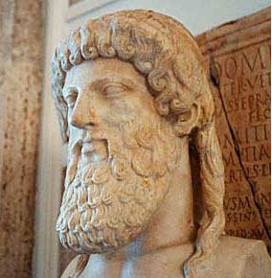
Question #3 What is Our Role in Society?
Reflects our thinking about human nature and the nature of society.
Democracy (our society) depends on participation.
Greek philosopher Plato
(4th Century) believed that
the community is best served
by citizens doing what they do
best. Your role is determined
by your natural abilities.

Slide 21
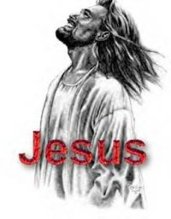
Our Role in Society…
Has to do with more than just your career.
Our roles in society have to do with purpose.
WHAT IS THE PURPOSE WE SERVE IN THE WORLD?

Slide 22
What is my role in a democratic society?
In democratic Canada, my role in society must be determined in part by what kind of citizen you choose to become.
Your actions and beliefs shape your purpose, and they have an effect on society and the people around you.

Slide 23
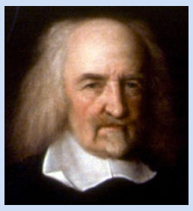
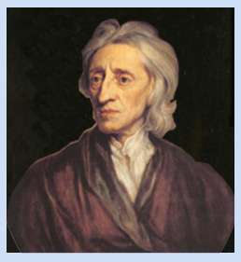
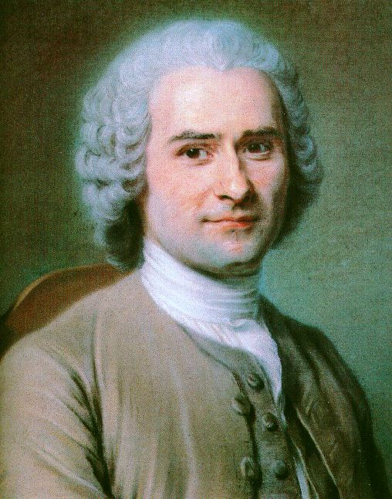
philosophers profoundly impacting and shaping western ideologies….

Slide 24
Thomas Hobbes (1588-1679)
English philosopher who lived during the English Civil War
Human nature is characterized by fear, violence and dangerous self-interest (extreme individualism)
Need security more than we need freedom
Solution: everyone gives freedom up to one person (monarch or dictator)
Wrote Leviathan (1651) a key text in Western political philosophy

Slide 25
John Locke (1632-1704)
People are rational, intelligent, and reasonable.
Divine Right of Kings – power resting with God and the king.
Source of power was with people themselves.
Gov’t exists to protect life, liberty and property.
Gov’t action needed to be justified by popular consent
Wrote on individual rights which became key ideology of liberalism

Slide 26
Jean-Jacques Rousseau (1712-1778)
Believed private property and owernership of land led to jealousy and corruption
Contributed to Denis Diderot’s Encyclopedia
Swiss philosopher interested in the common good.
People are inherently good and have been corrupted by civilization and society
Humans are naturally free and equal “Man is born free; and everywhere he is in chains”
Wanted to strip humans of aspects of wealth and influence in society
Opposed representative democracy-citizens should make laws

Slide 27
Hobbes, Locke, Rousseau…
Task:
Choose which philosopher you agree with the most and give evidence to support your position. Write a brief statement of your opinion.
Choose which philosopher you agree with the least and give evidence to support your position. Write a brief statement of your opinion.
Be prepared to discuss your reasons in small groups.

Slide 28
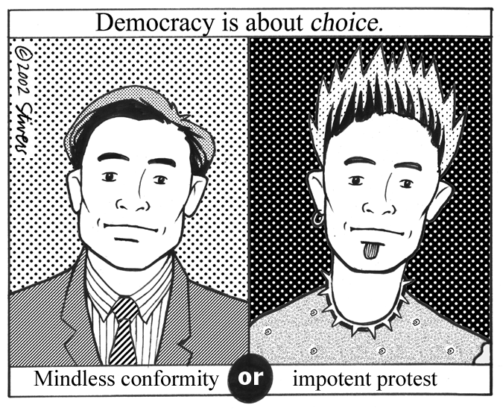
Moving Forward…
In Canada, choice is embedded in our lives.

Slide 29
To what extent should we embrace an ideology?
Is designed to make you think about the choices that lie ahead of you and how you will confront the issues that face your community, country and humanity.

